Slide 1


Study Skills How to Learn Reading & Writing skills

Slide 2


About me
HOANG LUU LY (Ms)
Lecturer at Hanoi University
Contact info: lyhl@hanu.edu.vn

Slide 3
Assessment
Participation: 10%
Quiz: 30%
Reflection: 60%

Slide 4
Lead-in
Nearly 58% of the world’s websites are in English, making it the dominant language on the Internet.
According to a survey by VietnamWorks, approximately 90% of job postings in industries like IT, finance, and marketing require English proficiency. Employees with strong English skills earn salaries 30-50% higher than those without.
According to a report in 2021, 80% of Vietnamese respondents considered English to be important for their current job; however, there are only about 30% of students after graduation meeting employers’ English requirements

Slide 5

Contents
How to study Reading Skill
How to study Writing Skill
Course Overview

Slide 6

What do you find most challenging about reading?

Slide 7
Reading
Ways of Reading
Predicting
Practice

Slide 8
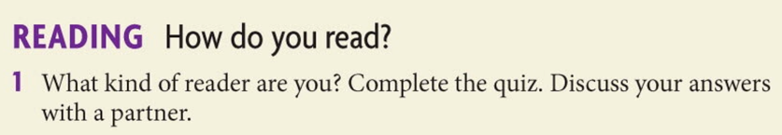


Slide 9
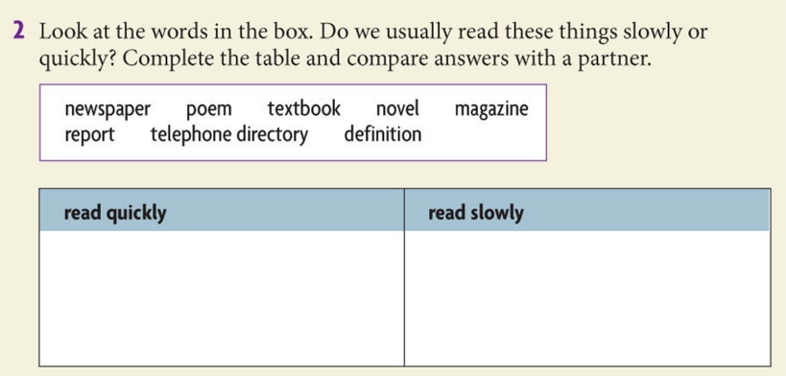
newspaper
magazine
report
novel
textbook
poem
Telephone directory
definition

Slide 10
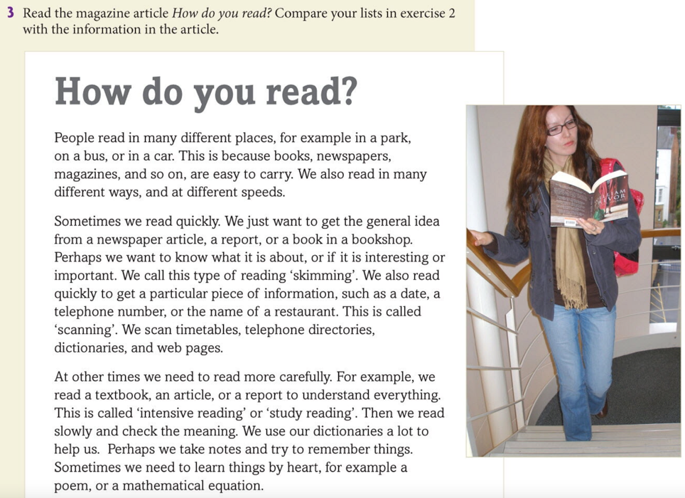

Slide 11


Reflect: How do you read
Work in groups of 2-3
Tell the other members what you can remember from the text

Slide 12


Basic ways of reading
 | Skimming | Scanning
What is it? | Read a text quickly to find out the general theme, topic, or meaning | Read a text quickly to find out specific information e.g. names, years.
When do we use it? | Pre-reading tasks Texts that don’t need a lot of detailed attention | - Answer types of questions that ask for details - Already know what you’re looking for
How do we do it? | Read the title Read the headings, subheadings, illustration captions Read the first and last paragraph Read the topic sentence of each paragraph | Identify the organization of the content before you begin Look for key words and related words as your eyes move quickly over the text Look for the information in all formats: charts, graphs, maps, captions

Slide 13
Intensive Reading & Extensive Reading
Intensive Reading | Extensive Reading
Comprehensive Read in details with specific learning aims and tasks Academic-purpose texts 100 % understadning (word for word, use dictionaries) | Supplementary Read for pleasure Various kinds of texts Overall understanding (fluent reading, infer the meanings of unknown words)

Slide 14

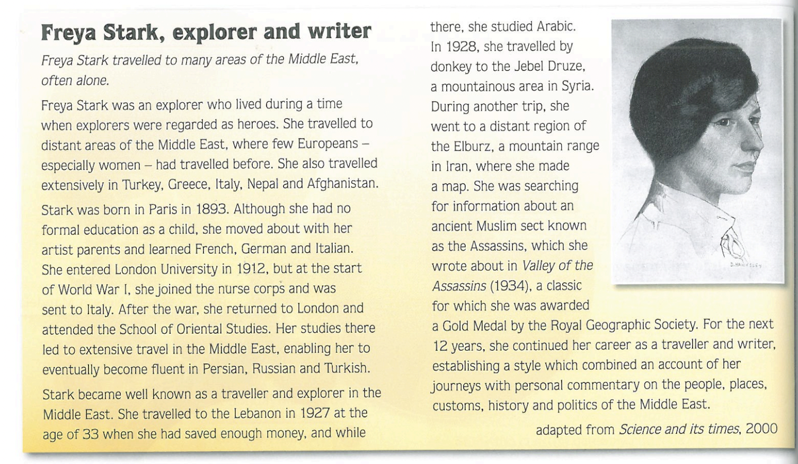
Extensive or Intensive?
extensive
intensive

Slide 15
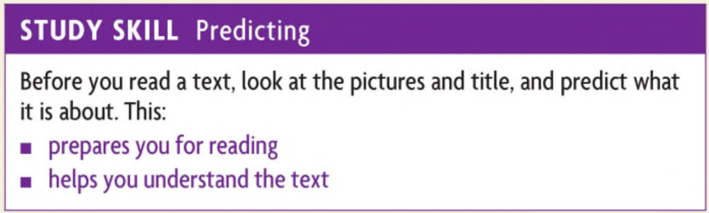

Slide 16
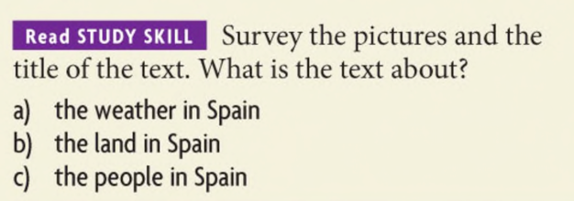
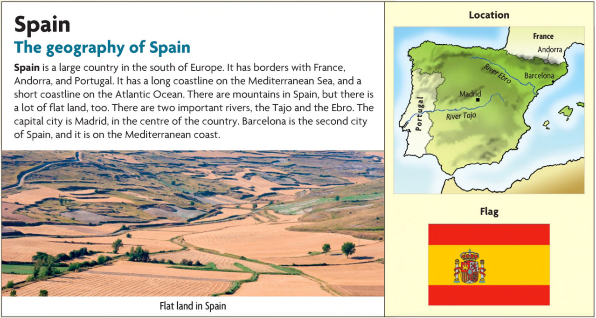

Slide 17


Slide 18
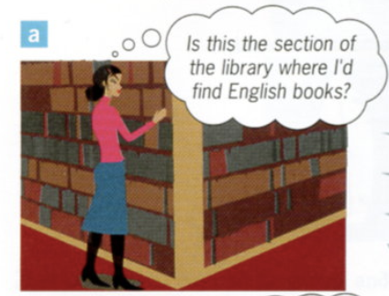
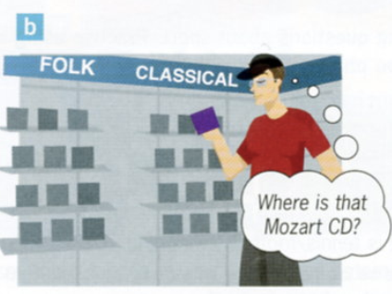
scanning
scanning

Slide 19
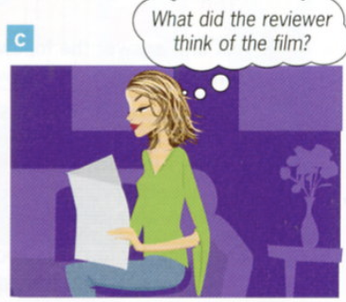
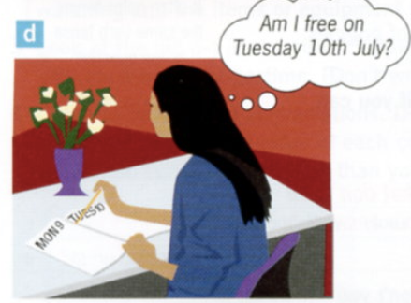
skimming
scanning

Slide 20
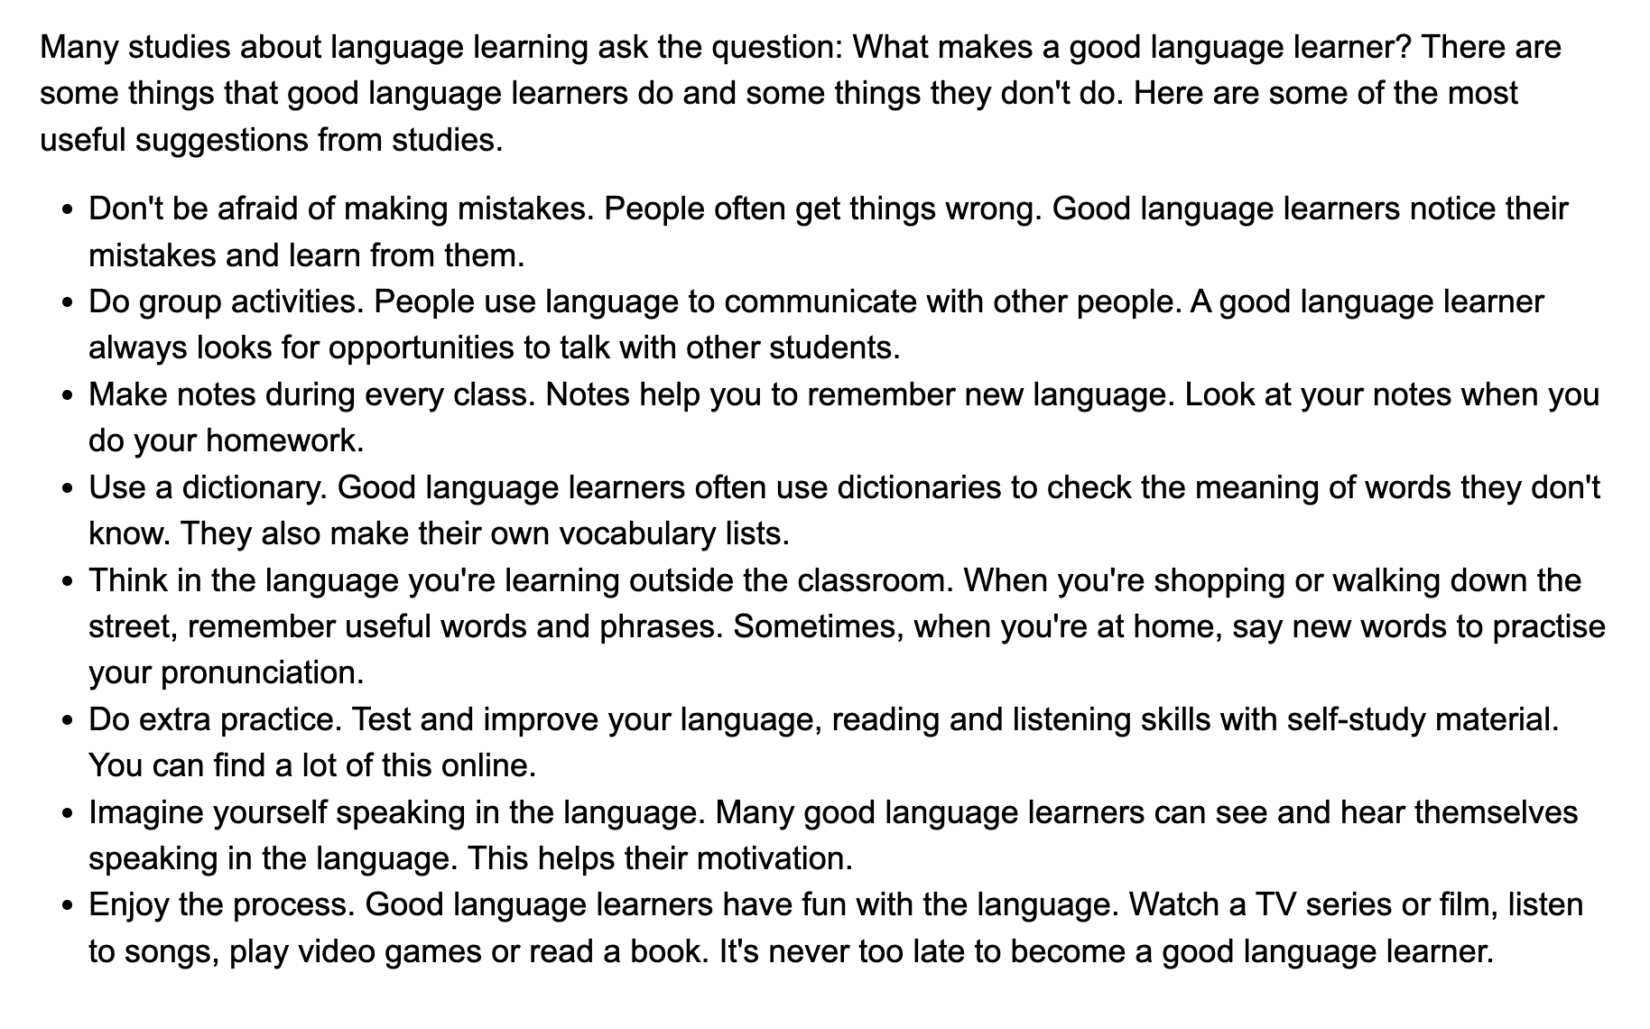
Study Skills Tips

Slide 21
What other tips do you have for learning a new language?

Slide 22
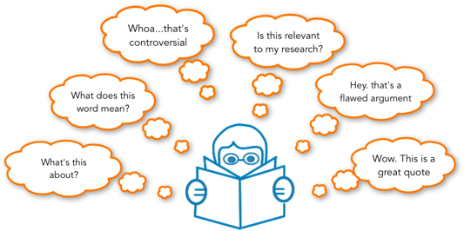
Active Reading Strategies

Slide 23

Active Reading Strategies
Identify Unfamiliar Words and Phrases
Make Notes, Outlines or Highlights
Learn the Main idea and Key concepts
Ask Questions – Lots of Them
Think Beyond the Text
Write or Present a Book Summary

Slide 24

Vocabulary Building Strategies
Dictionary work
Recording vocabulary
Instructions

Slide 25
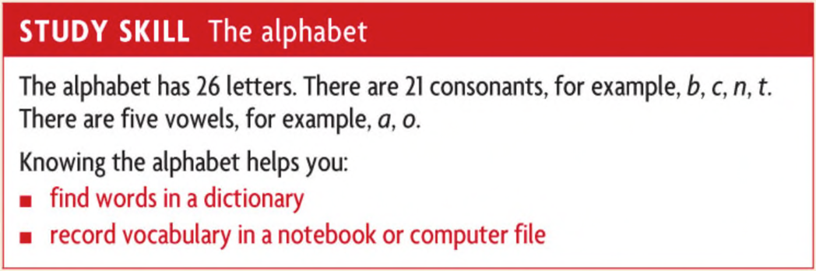

Slide 26
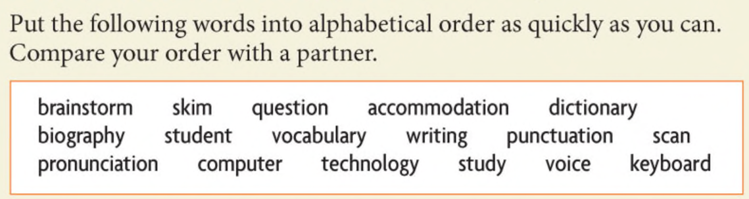
accommodation
biography
brainstorm
computer
dictionary
keyboard
pronunciation
punctuation
question
scan
skim
student
study
technology
vocabulary
voice
writing

Slide 27
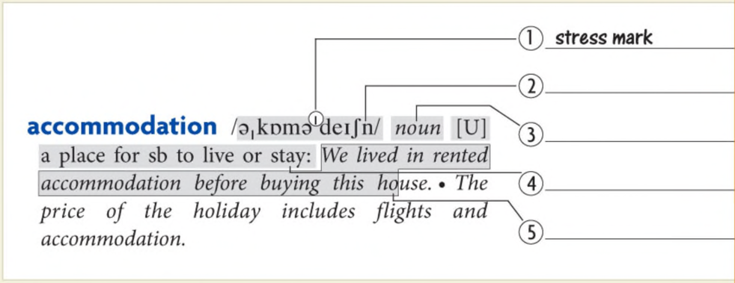
Here is an entry from the Oxford Student’s Dictionary. Label the parts of the entry 1-5 using the words in the box.
part of speech definition pronunciation example sentence stress mark
pronunciation
Part of speech
definition
Example sentence

Slide 28
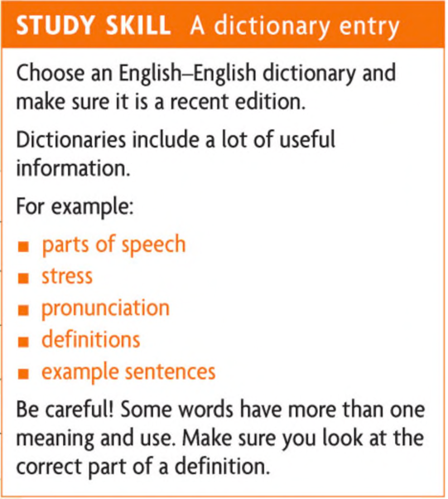

Slide 29
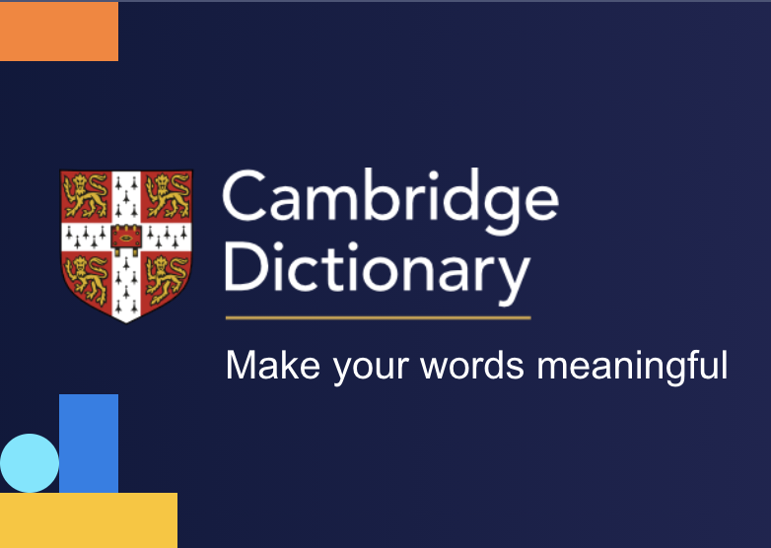

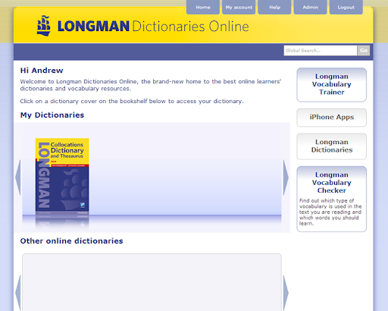
Reliable dictionary sources

Slide 30
Use your dictionary to answer these questions
What part of speech is the word how?
How many floors does a bungalow typically have?
What is the American English equivalent of the British noun lorry?
What is the opposite of the word difficult?
How do we pronounce the word restaurant?
What is the past tense of the verb buy?
What do we call a person who plays the piano?
What does the word break mean in this sentence: “I see it’s approaching lunchtime, so let’s take a break”?
adverb
1
truck
easy
/ˈres.trɒnt/
bought
pianist
A short break of rest
Notes:
temperature

Slide 31



Recording Vocabulary
WORD CARDS
MIND MAPS
TABLES

Slide 32
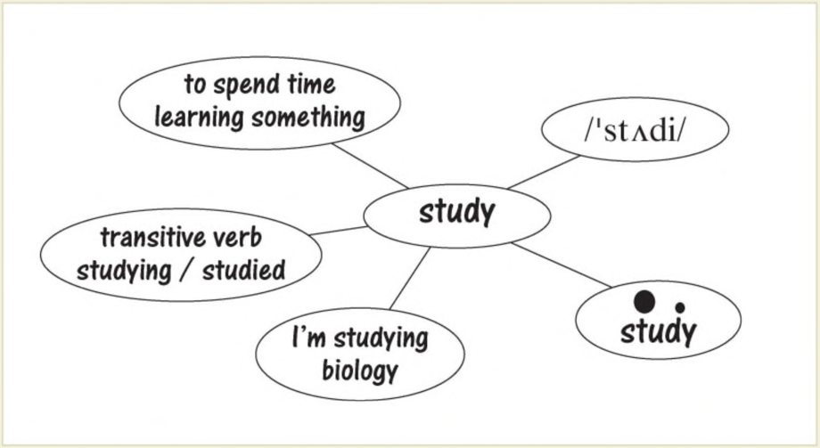
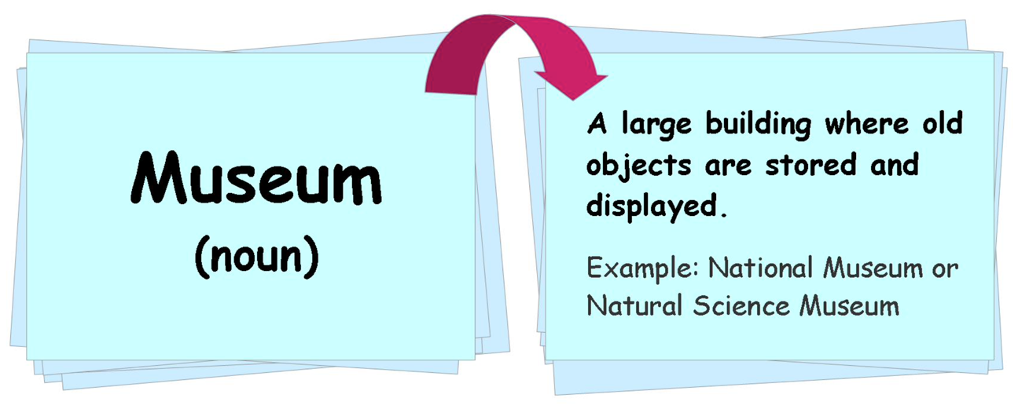
Word cards
https://quizlet.com/

Slide 33
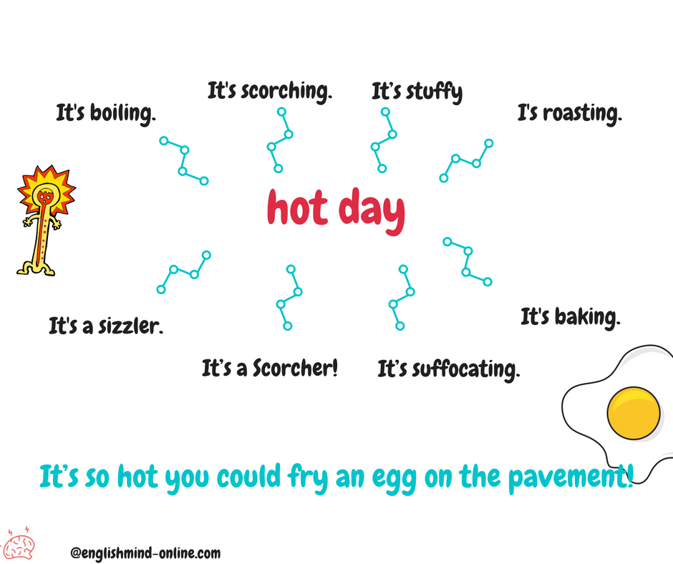
Mind maps

Slide 34
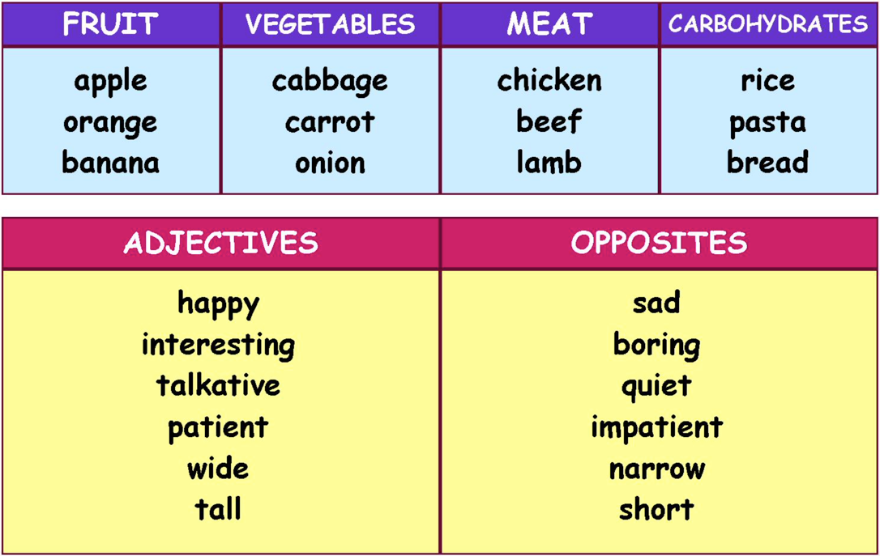
Tables

Slide 35
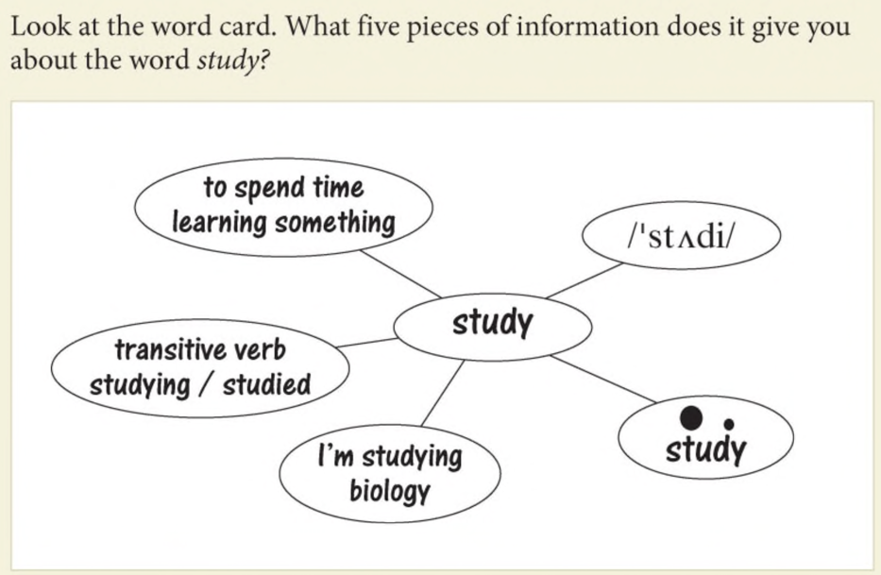

Slide 36

Note
Wherever you record new vocabulary, it is helpful to note more than the translation. Also note, for example:
■ the pronunciation
■ the stressed syllables
■ part of speech
■ associated words and grammar, e.g., a biography of someone

Slide 37
Make word cards for the underlined words 1-6. Use your dictionary.
I am studying Medical Science.
We scan a timetable to get the information we want.
Correct punctuation is very important in good writing.
Always check in a dictionary if you are not sure how a word is spelt.
A biography is the story of someone’s life.
Novels, plays, and poetry are examples of literature.

Slide 38



III. Writing
Punctuation
Brainstorm
Checking your writing

Slide 39
Read the text & identify its weaknesses
I want to talk about my family. My family is very important for me. We live in a big house near the park. My mom is kind and she cook delicious food. My dad is a teacher, and he is very funny. I have a brother. He like football very much, and he play every day after school. My sister don’t like sport, she like read books. We goes to the park every weekend. I love my family, they are the best.
Grammar errors: subject-verb agreement
Repetition: overuse of simple sentence structures
Limited vocabulary: repetition of words like, very
Cohesion: lack of connecting words (however, because, etc)
Informal/ spoken language: don’t, want to talk

Slide 40
Group Work Task
Dos
Don’ts
…
…
…
…
…
…
…
…
…
…

Slide 41
The Don’ts
What to avoid?

Slide 42
Don’ts
Contractions
I’ll → I will
We can’t → We cannot

Slide 43
Don’ts
Informal/Spoken Words and Phrases
kids, guys, stuff
a little bit, a lot of, lots of
This essay talks about…
I want to say that …
A solution I would like to suggest is …

Slide 44
Don’ts
And, Or, But at Sentence Beginnings
And there are some advantages too.
But there are also some disadvantages.

Slide 45
Don’ts
First-person pronouns (I, We)
I think people should… →
It is advisable that …

Slide 46
Don’ts
“You” to address the reader directly
Doing sports is good for you.

Slide 47
Don’ts
Asking Questions
So what are the benefits of doing sports? This essay will discuss …

Slide 48
The Dos
What’s the Norm?

Slide 49
Dos
Words in Full
laboratory, NOT lab,
vocabulary, NOT vocab

Slide 50
Dos
Impersonal, Passive Constructions
It is suggested that …

Slide 51
Dos
Hedging Language
The earth will get warmer.
Scientists predict that the earth will get warmer.
It is predicted that the earth will get warmer.

Slide 52
Writing Process
Pre-writing
- Reading
- Planning
Brainstorming, outline
While Writing
- Drafting
- Revising
Post – writing
- Editing
- Feedback
Rewriting
Notes:
PEEL
P – point of view
E – explanation
E – evidence/ example
L - Link

Slide 53
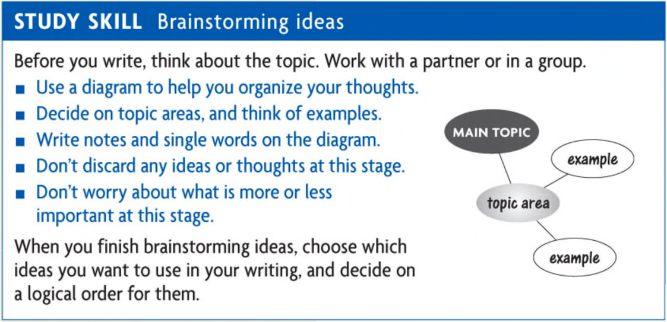

Slide 54
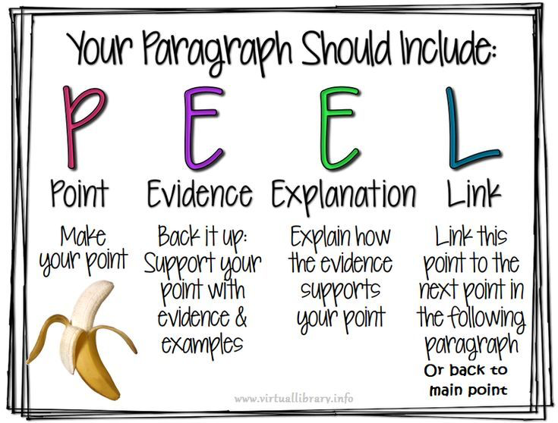

Slide 55
Sample
English studies play a crucial role in helping students develop strong communication and critical thinking skills. Through reading literature, students are exposed to diverse ideas, cultures, and perspectives, while writing tasks help them learn to express their thoughts clearly and persuasively. These skills are essential not only for academic success but also for participating effectively in society and the workplace, where clear communication and thoughtful analysis are highly valued. Therefore, English studies are far more than just learning grammar or reading stories—they prepare students to engage with the world in meaningful and intelligent ways.

Slide 56
Checking your writing
Every time you write, remember to check your work for:
capital letters at the beginning of sentences and for proper nouns (names of people, cities and countries)
full stops or question marks at the end of sentences
grammar mistakes
spelling mistakes. Use a dictionary or computer spellchecker to check your spelling. Keep a record of any words you misspell. Learn the correct spelling.

Slide 57

Wrap - up
What do you find most interesting about the lecture? About learning English language?

Slide 58

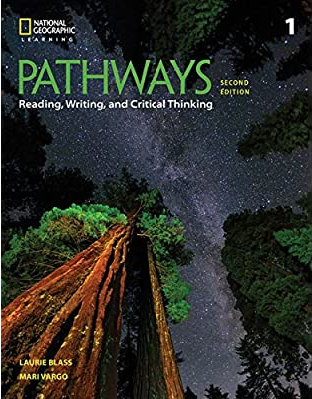

Slide 59
MATERIALS:
Listening and Speaking: Pathways 1 Listening, Speaking and Critical thinking, 2nd edition (Chase, T., B., and Joannsen L., K., National Geographic Learning, 2018)
Reading and Writing: Pathways 1 Reading, Writing and Critical thinking, 2nd edition (Vargo, M., & Blass, L., National Geographic Learning, 2018)
Longman Writing Series 2: From paragraphs to essays, 4th edition (Oshima, A., & Houge, A., Pearson Education, 2017)
ASSESSMENT
Listening:
Participation (my ELT + in-class participation): 10%
Progress test: 30%
Final test: 60%
Speaking:
Participation (my ELT + in-class participation): 10%
Speaking progress test: 30%
Final test: 60%
Reading:
Participation (my ELT + in-class participation):10%
Progress test: 30%
Final test: 60%
Writing:
Participation (my ELT + in-class participation): 10%
Participation: 30%
Final: 60%
Note: Progress tests are due in Week 6

Slide 60
References
Donald, Sydney G 2001, Study Skills for Language Students: A Practical Guide, Oxford University Press.
https://learnenglishteens.britishcouncil.org/exams/grammar-and-vocabulary-exams/mind-maps
https://learnenglishteens.britishcouncil.org/exams/grammar-and-vocabulary-exams/recording-vocabulary

Slide 61


